Slide 1

ireland… and more
Matteo Caneva & Enrico Pezzano

Slide 2
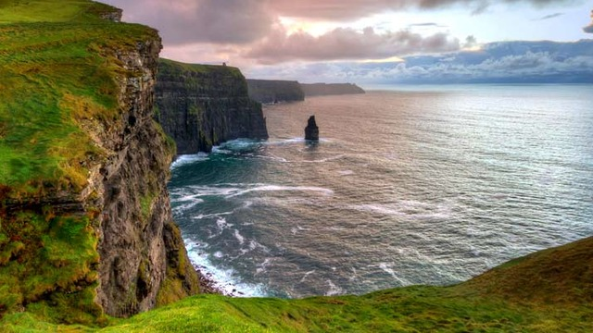
Mission Tank // Kelly Capris

Slide 3
La collezione

Slide 4
History

Slide 5
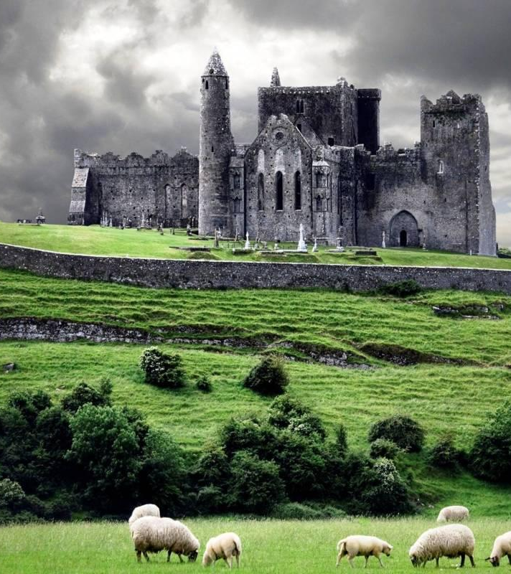
Scelti da persona
Prehistoric Ireland
Emergence of Celtic Ireland
The Kingdom of Ireland
Union with Great Britain
Indipendence

Slide 6
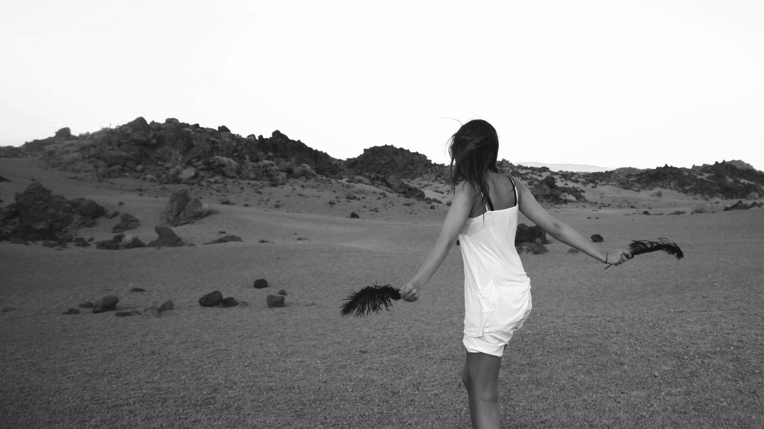
Mission Tank // Kelly Capris

